Slide 1
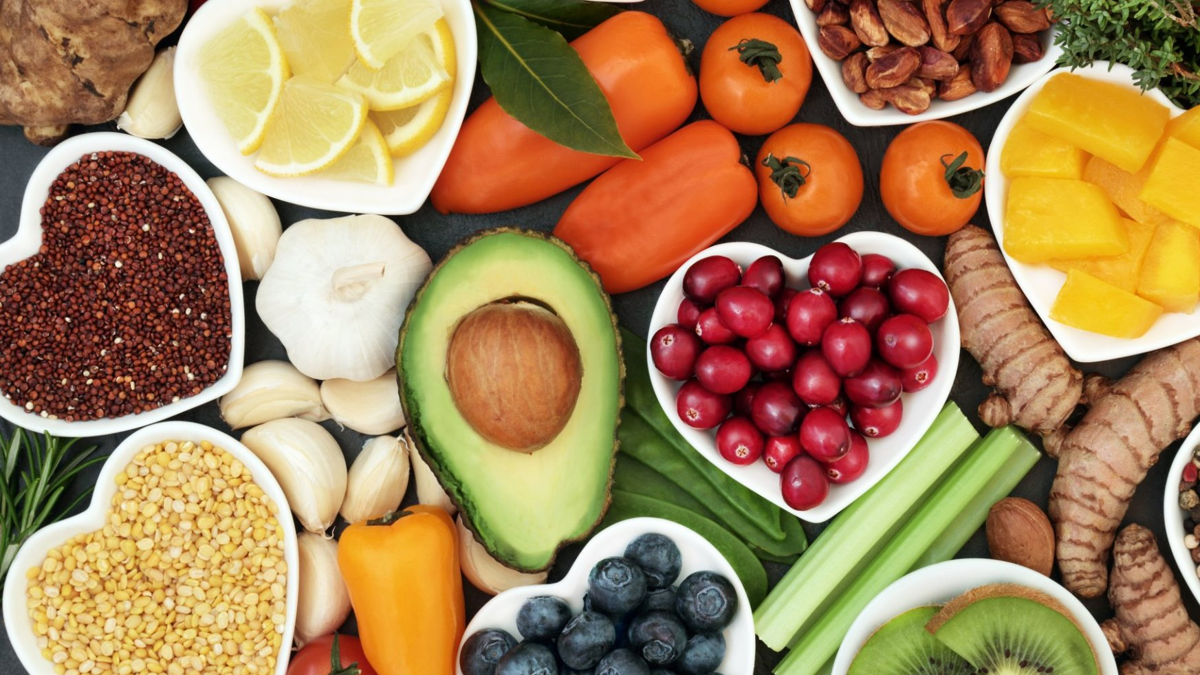
Leading the Food Industry to Help the Environment
Red Team Hackathon 2020
Emily Heeb, Emma Koslow, Chris Kruger, Chen Stanilovsky

Slide 2



Introductions
Emily Heeb
Junior at the University of South Carolina studying International Business, Management Entrepreneurship, and Spanish
Passionate about sustainability (vegetarian, currently attempting a 0-waste lifestyle)
Emma Koslow
Sophomore at UNC-Chapel Hill studying CS and Communications
Passionate about accessibility within computer science and technology
Chris Kruger
Sophomore at Stevens Institute of Technology studying Computer Engineering
Passionate about the environment due to living near farms
Chen Stanilovsky
Sophomore at CUNY Hunter College with a major in Computer Science
Passionate about leveraging the power of technology to help the world

Slide 3
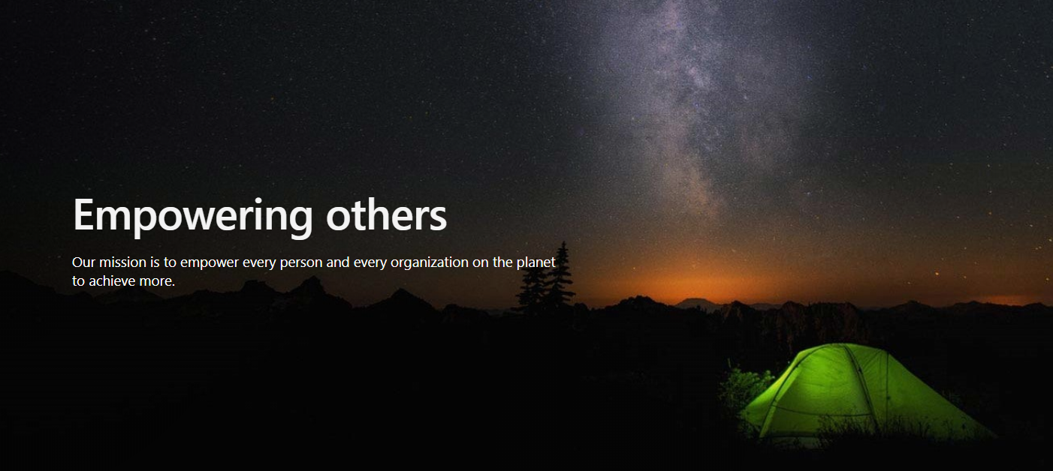
Challenge
To produce an idea as a team to help promote one idea of Microsoft's mission

Slide 4

Microsoft Mission & Core Values
“…to empower every person and every organization on the planet to achieve more”
Sustainability goal
Accountability
Ethics
Diversity and Inclusion
Health

Slide 5








The Idea
Notes:
Our Idea: Using a camera api to develop a QR reader, to create a technology for consumers in places, such as Grocery stores, to scan an item and understand the product/company’s contribution to climate change through sustainability ratings of company history, energy consumption, transportation. The app will also display similar options and customer ratings

Slide 6

Our Mission:
We strive to empower individuals and organizations with a tool to help take meaningful action against their carbon footprint through mindful awareness of the impact caused by the food they consume

Slide 7
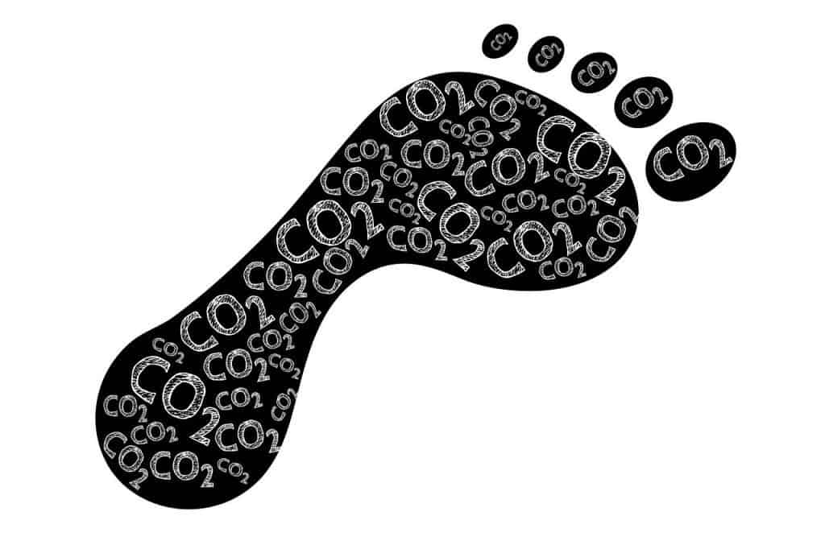
Carbon Footprint
Amount of greenhouse gases left behind from different activities
Notes:
Green house gases includes carbon dioxide and methane
Average carbon footprint is 16 tons in the United States.
Globally it is 4 tons
Lower our footprint allows for the world to recover from global warming and to help reduce the effect on the environment
To lower it, you may make small changes like shorter showers, less flights, line drying our clothes, and eating less meat which is what we will talk about

Slide 8

Target Market
Shoppers
Reduce carbon footprint
Compare companies
Become informed
Notes:
Talk about how it will affect shoppers/stores/producers in price, demand, real estate in storing it, etc.

Slide 9
Others Affected
Stores
Item demand and inventory
Customer access
Sales
Optimize impact
Producers
Item demand
Inventory
Improve target markets
Sales
Optimize impact

Slide 10

Statistics

Slide 11
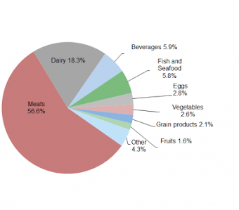
Sustainability in communities
*includes transportation
Food causes 26% of greenhouse gasses (BBC)
77% want to learn about sustainable lifestyles (Forbes)
Self-efficacy and confidence (HBR)
Break bad habits, encourage positivity (HBR)

Slide 12

Sustainability of companies
77% more willing to buy from sustainable companies (SR)
90% of executives find sustainability to be important (imd)
60% incorporate sustainability in their strategy (imd)
25% incorporate sustainability in their business plan (imd)
"Simply put, sustainability is a business approach to creating long-term value by taking into consideration how a given organization operates in the ecological, social and economic environment. Sustainability is built on the assumption that developing such strategies foster company longevity." - Knut Haanes (imd)

Slide 13
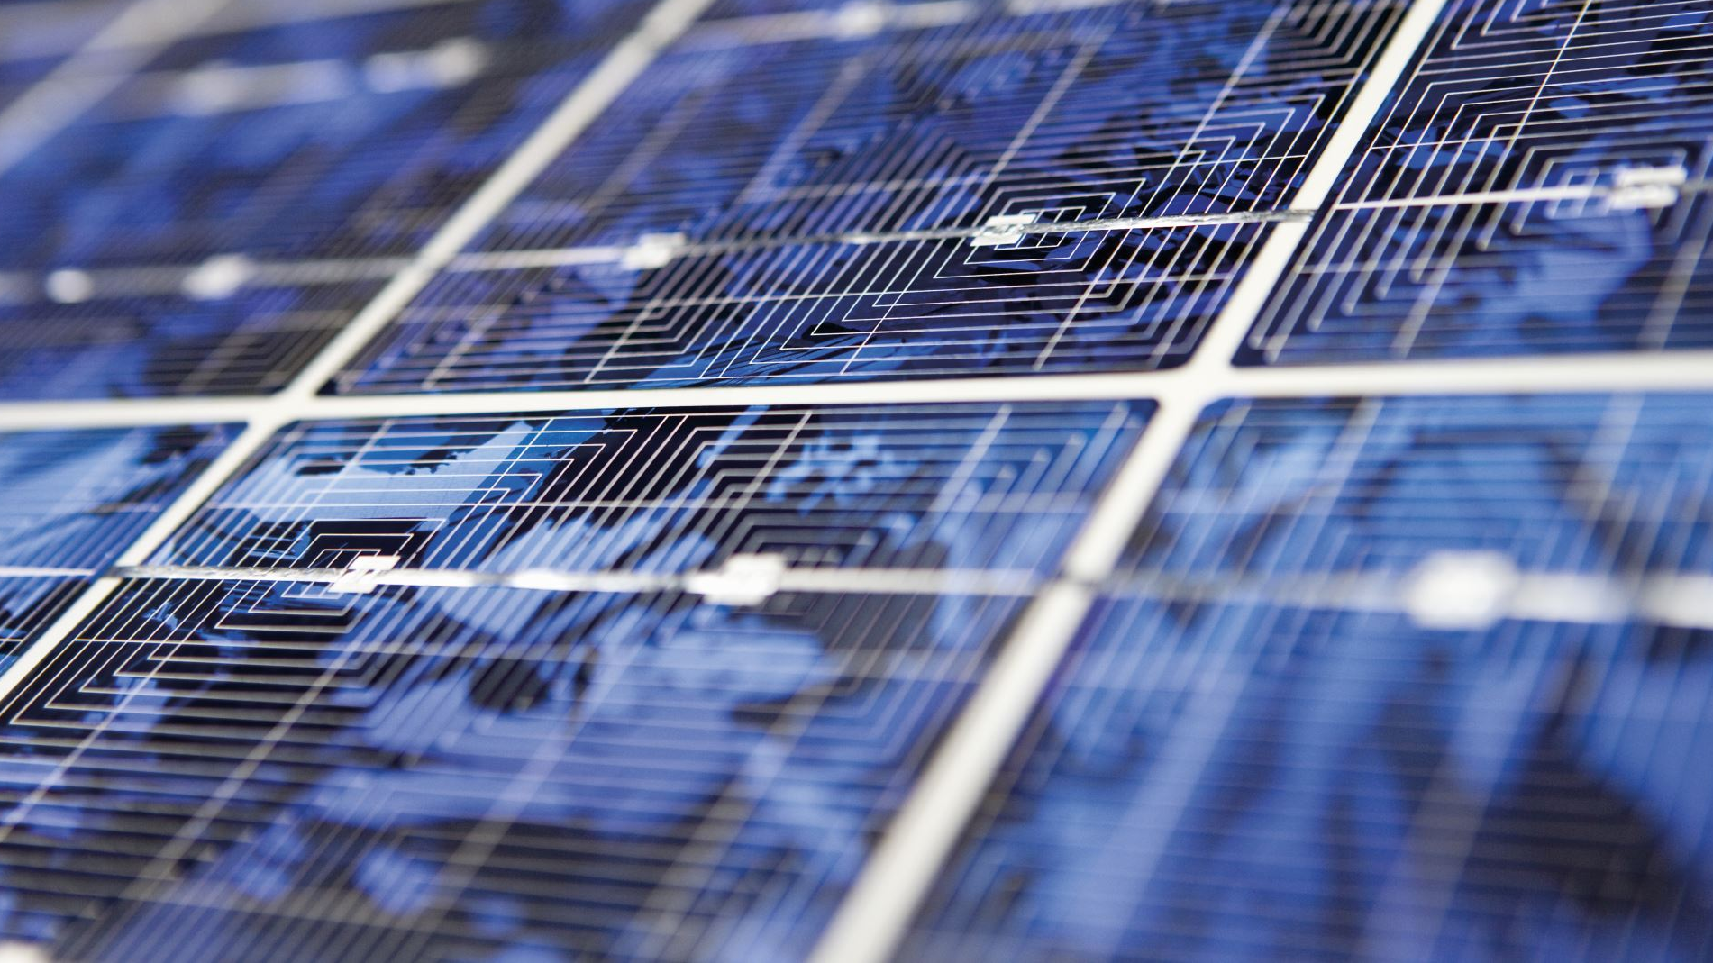
The Tech Behind It All

Slide 14

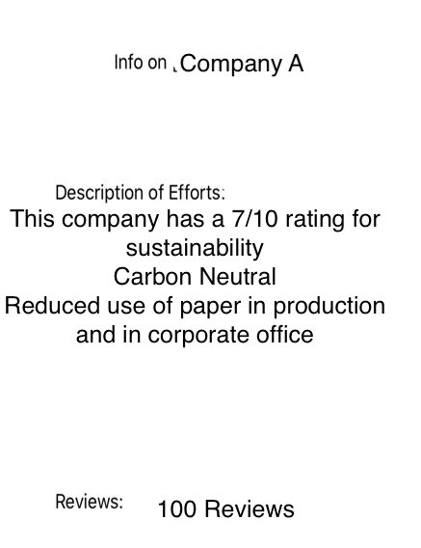
How does this technology work?

Slide 15
How does this technology work?
Use any modern-day smart phone
Camera scans QR code
QR code is used to determine which company the product is coming from
Based on the company, sustainability data is retrieved and presented in a fashion that is easy to consume

Slide 16
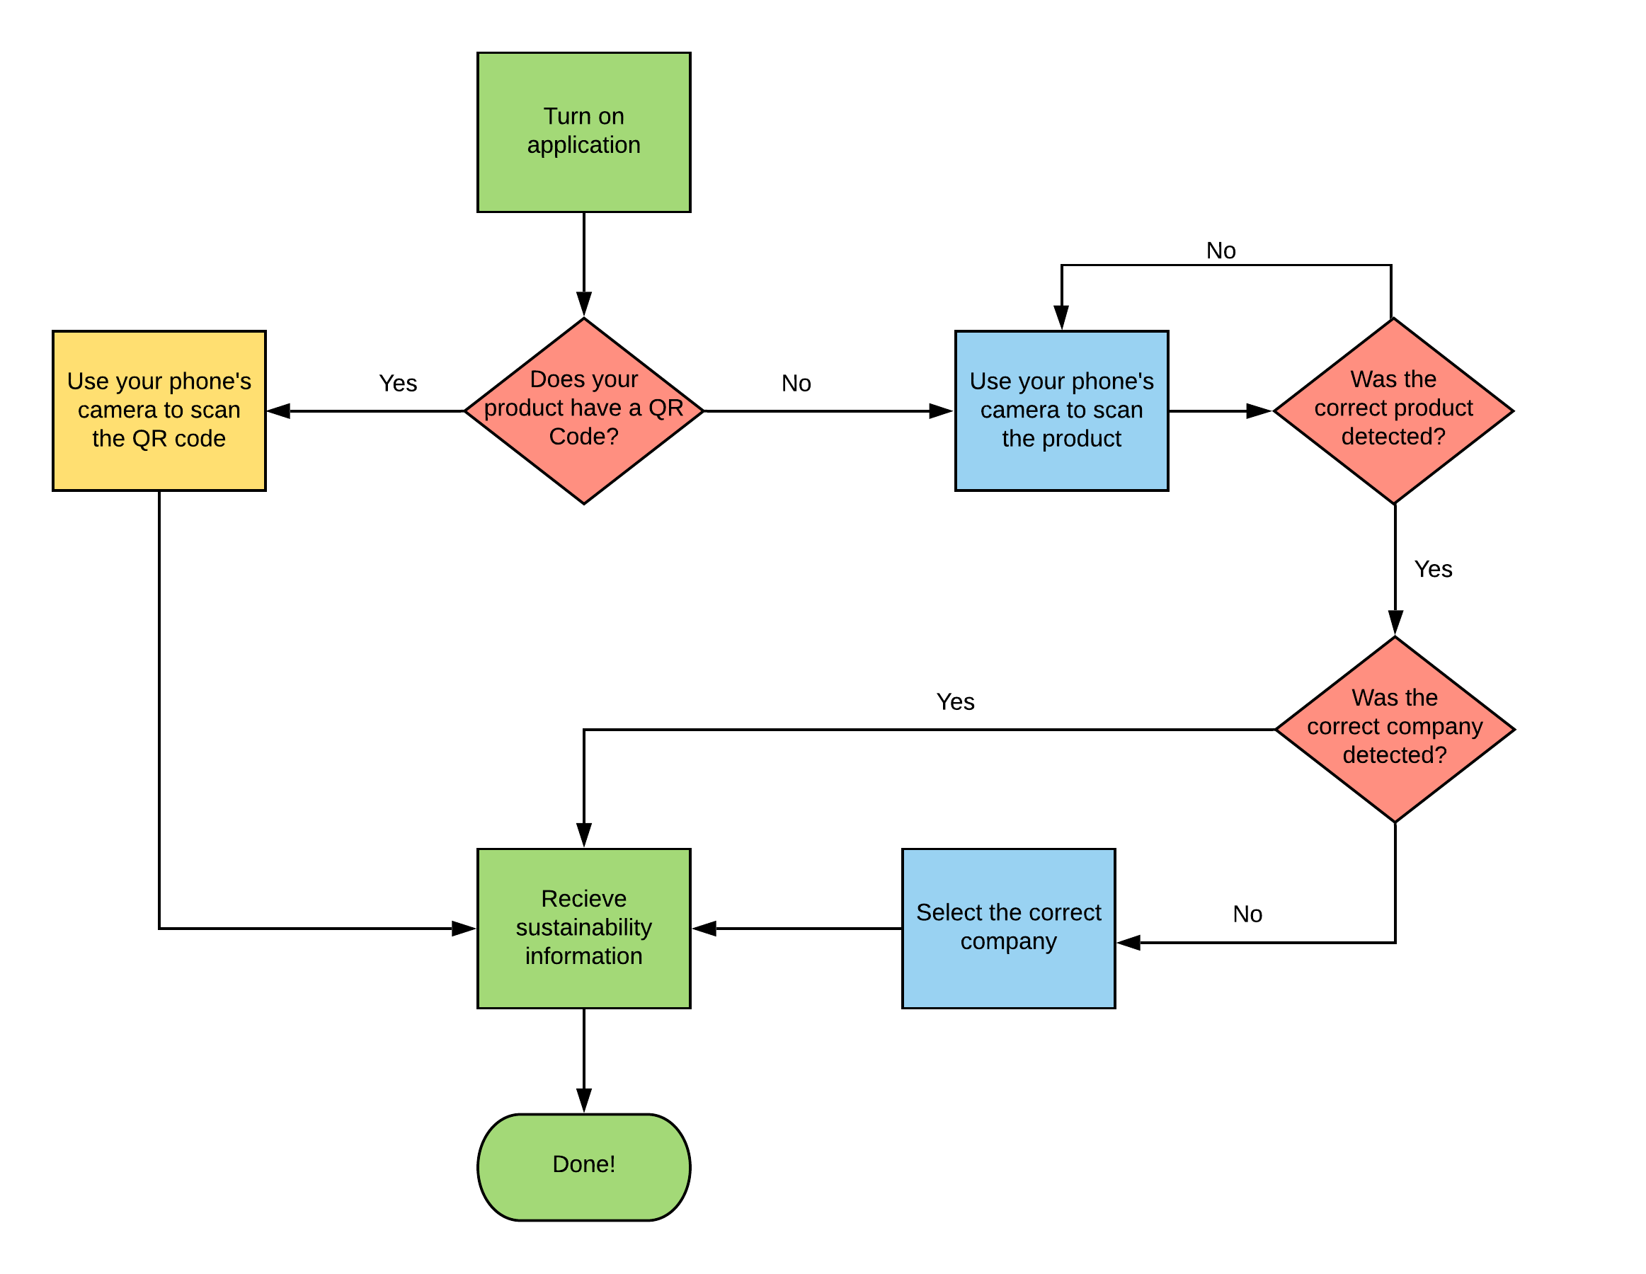
The Flow Of Using The Program

Slide 17

Future Expansions
Add alternate products as suggestions that are more sustainable
Make grades for supermarkets depending on if their products are from companies that are following sustainability
Web extension for online shopping

Slide 18
Machine Learning!
Not all products have QR codes
Produce, meats, etc...
What do we do when we cannot scan a QR code?
We can use computer vision!
We cannot use a QR scanner as our only tool!
Why?

Slide 19

Computer Vision
The extraction of data from images and videos
In our program we can use Computer Vision to:
Determine what type of product the user is trying to scan
Apple, grape, celery, etc...
Determine what company the product originates from
Dole, Chiquita, SunFruits, etc...
What if the app cannot determine the company?
Ask the user after scanning!

Slide 20
Microsoft and Computer Vision
Azure allows people to create computer vision/AI applications using their API
Makes it easier for intelligent applications to be deployed and distributed
Provides pre-trained models which are ready to be specialized to whatever task is necessary

Slide 21

The Effects for All Users

Slide 22
Influence on the Workplace
Will assist companies with being more cautious about the sustainability of their products
Allow distributers to find products that are good for the environment

Slide 23
The Issues (Pros/Cons)
Pros:
Cons:
Change
Unhappy
Helpful
Educates
Influence

Slide 24

Opportunities for consumers
Become educated about which products are good for sustainability
Be influenced in how what you consume affects each buyer's carbon footprint
Influence others to do the same

Slide 25
Summary
Mobile application that leverages computer vision to provide users with sustainability information
Used a camera as a QR reader or computer vision API if a code is unavailable
Provide individuals with tools to learn about and reduce their carbon footprint within the food industry

Slide 26
Q&A

Slide 27
Sources
https://timeforchange.org/what-is-a-carbon-footprint-definition/
https://hbr.org/2019/07/the-elusive-green-consumer
https://www.bbc.com/news/science-environment-46459714
https://www.forbes.com/sites/jamesellsmoor/2019/07/23/77-of-people-want-to-learn-how-to-live-more-sustainably/#98e7a7a2b011
https://www.smartrecruiters.com/blog/top-corporate-social-responsibility-trends-in-2020/
https://www.imd.org/research-knowledge/articles/why-all-businesses-should-embrace-sustainability/#:~:text=Simply%20put%2C%20sustainability%20is%20a,such%20strategies%20foster%20company%20longevity.
https://www.inc.com/karen-schrier/4-brilliant-ideas-you-should-steal-from-food-industry.html
https://blogs.microsoft.com/blog/2020/01/16/microsoft-will-be-carbon-negative-by-2030/

